Slide 1
RAG-Based Customer Support Assistant
Technical Documentation
A Multi-Agent System with LangGraph Orchestration & HITL Verification

Slide 2
1. Introduction
1.1 What is RAG?
Retrieval-Augmented Generation (RAG) is an AI architecture that combines information retrieval with Large Language Models (LLMs) to generate accurate, context-aware responses. Instead of relying only on the model’s pre-trained knowledge, RAG retrieves relevant information from an external knowledge base and uses that context to generate reliable answers.
This approach significantly reduces hallucination, improves factual accuracy, and ensures that responses are strictly grounded in company-specific documentation.
1.2 Why RAG is Needed
Traditional support systems rely on human agents manually searching through dense documentation, leading to delayed response times and high operational costs. A RAG-based system automates the delivery of "Source of Truth" data at scale.
1.3 Use Case: CloudNova Systems
This project implements a support assistant for CloudNova's infrastructure stack, handling:
Billing and Refund Processing
API Authentication and Access Management
Security Protocols & Password Management
Enterprise SLA Compliance & Troubleshooting

Slide 3
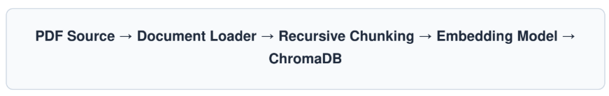
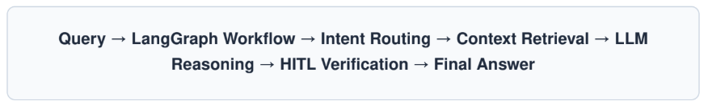
2. System Architecture Explanation
2.1 High-Level Architecture
The architecture is bifurcated into two distinct pipelines: Ingestion (Data Prep) and Inference (Real-time Querying).
Offline Ingestion Pipeline
Pre-processes the CloudNova Master Handbook into a vector-searchable format.
Online Query Lifecycle

Slide 4
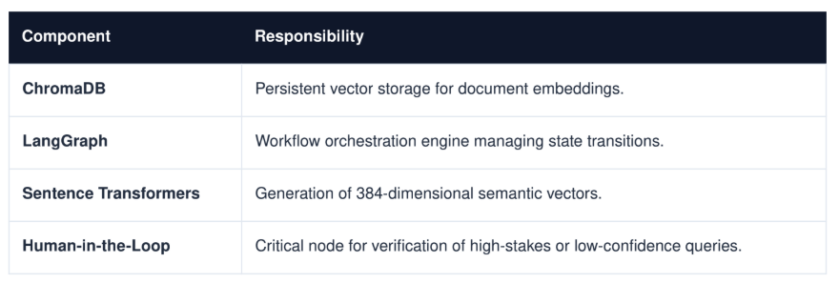
2. System Architecture Explanation
2.2 Component Interaction

Slide 5
3. Design Decisions
3.1 Chunk Size Strategy
Selection: 1000 characters with 200 character overlap. Small chunks improve precision but lose thematic context; larger chunks retain context but dilute semantic signals. The 1000/200 balance ensures that paragraph-level policies (like refund steps) remain atomic units.
3.2 Embedding & Retrieval
Model: all-MiniLM-L6-v2. This was chosen for its high throughput and low latency in production environments. We utilize Top-K Similarity Search (k=5) to provide the LLM with a comprehensive but concise context window.

Slide 6
4. Workflow Explanation (LangGraph)
4.1 Graph-Based Execution
Unlike linear chains, LangGraph allows for stateful, cyclic workflows. This is essential for Support bots that need to re-verify queries or pause for human feedback.
4.2 Node Responsibilities
Input Node: Normalizes query and captures metadata.
Retrieve Node: Queries ChromaDB for top relevant snippets.
Generate Node: Synthesizes answer using the LLM and retrieved context.
Confidence Node: Scores the generated answer.
HITL Node: The manual review gate for human intervention.
4.3 State Object Management
{
"query": "Can I get a refund?",
"retrieved_context": [...chunks...],
"confidence_score": 0.72,
"requires_hitl": true,
"final_response": null
}

Slide 7
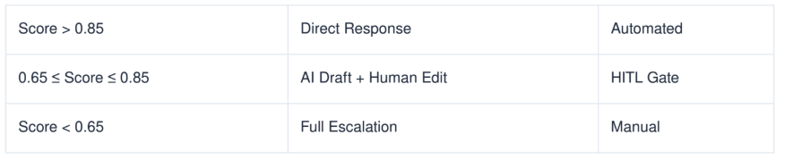
5. Conditional Logic & Routing
5.1 Routing Thresholds
5.2 Safety & Intent Detection
Queries containing sensitive keywords (e.g., "Legal", "Chargeback", "SLA Breach") trigger an
Immediate Escalation, bypassing the automated generation node to protect company liability.

Slide 8
6. HITL Implementation
HITL is not just a safety net; it is a collaborative interface between AI and Human Intelligence.
Human Agent Actions:
Approve: One-click delivery of AI-generated policy answers.
Edit: Modifying the AI draft to address specific nuances.
Override: Discarding the AI output for complex enterprise cases.

Slide 9
7. Challenges & Trade-offs
Latency vs. Context: Retrieving more chunks (k=10+) improves accuracy but doubles LLM generation time. We opted for k=5 for a <3s response goal.
Hallucination Guard: Strict system prompting prevents the model from "helping" with out- of-scope integrations (e.g., Salesforce), ensuring the brand doesn't promise unsupported features.
Cost vs. Performance: Using GPT-4 improves reasoning quality and policy compliance but increases operational cost significantly. Smaller open-source models reduce cost and latency but may reduce response quality for complex enterprise queries. Therefore, a hybrid strategy can be used where smaller models handle Tier-1 support and GPT-4 handles sensitive or escalated cases.

Slide 10
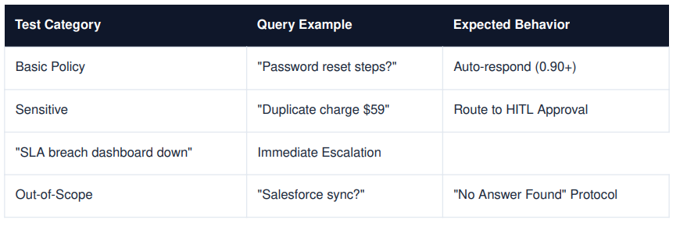
8. TESTING & VALIDATION
We utilize a multi-tier testing strategy to validate retrieval and routing.
Legal/Compliance

Slide 11
9. Future Enhancements
Feedback Re-Indexing: Automatically adding human-corrected answers back into ChromaDB to create a "Self-Improving" RAG.
Session Memory: Implementing window-based chat history to handle multi-turn troubleshooting.
Observability Dashboard: A production monitor for tracking retrieval failure rates and latency spikes.

